Slide 2
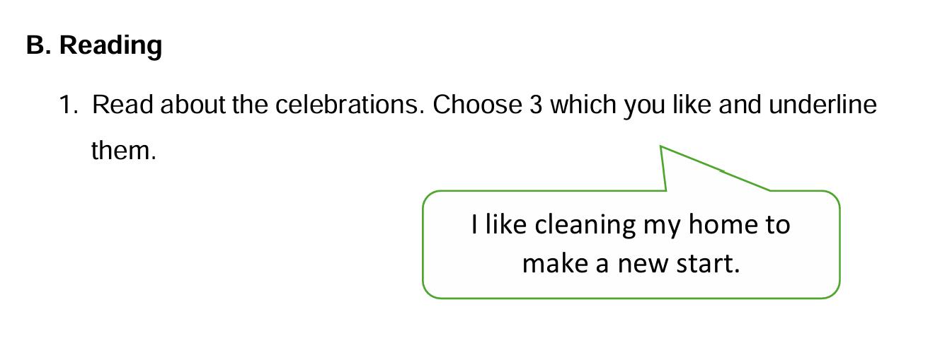

Slide 6
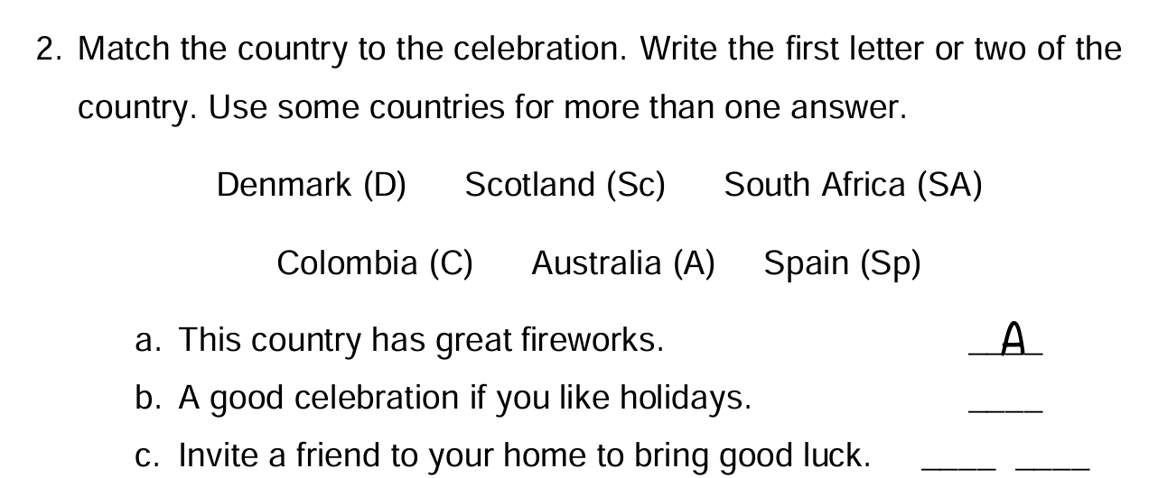

Slide 10
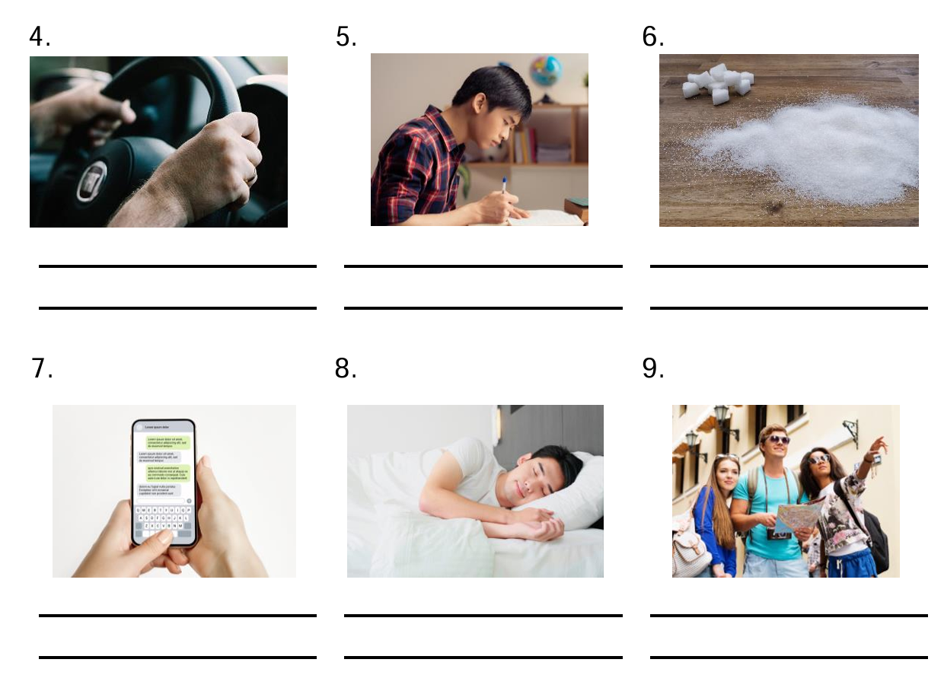

Slide 11
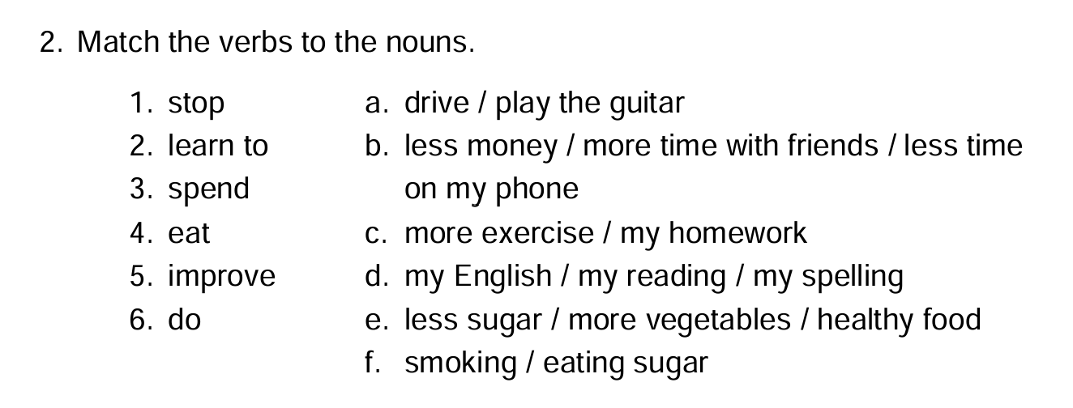

Slide 14
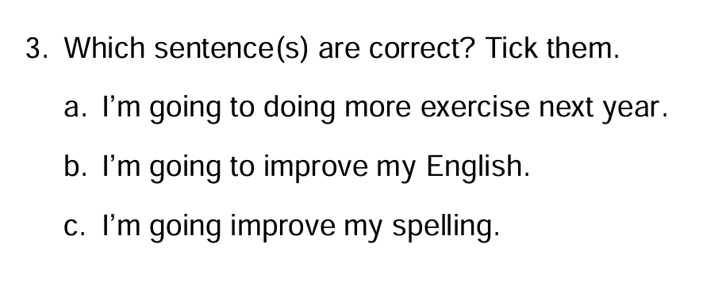

Slide 15
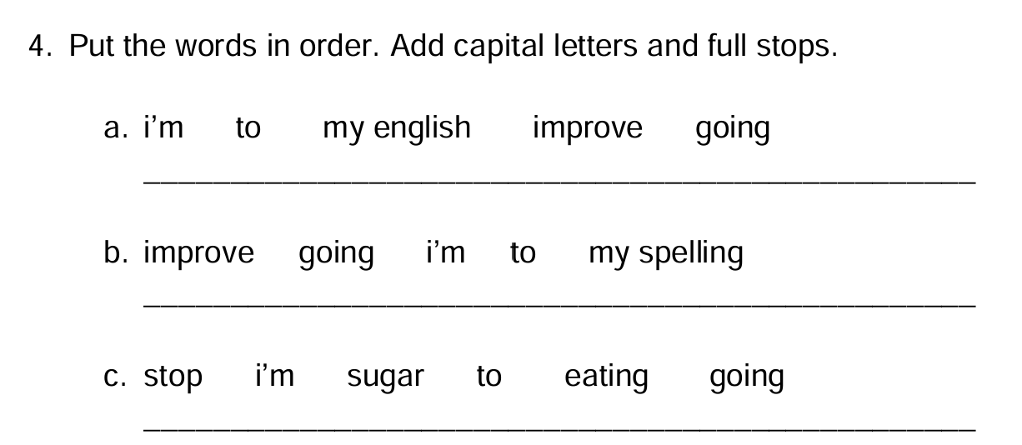

Slide 16
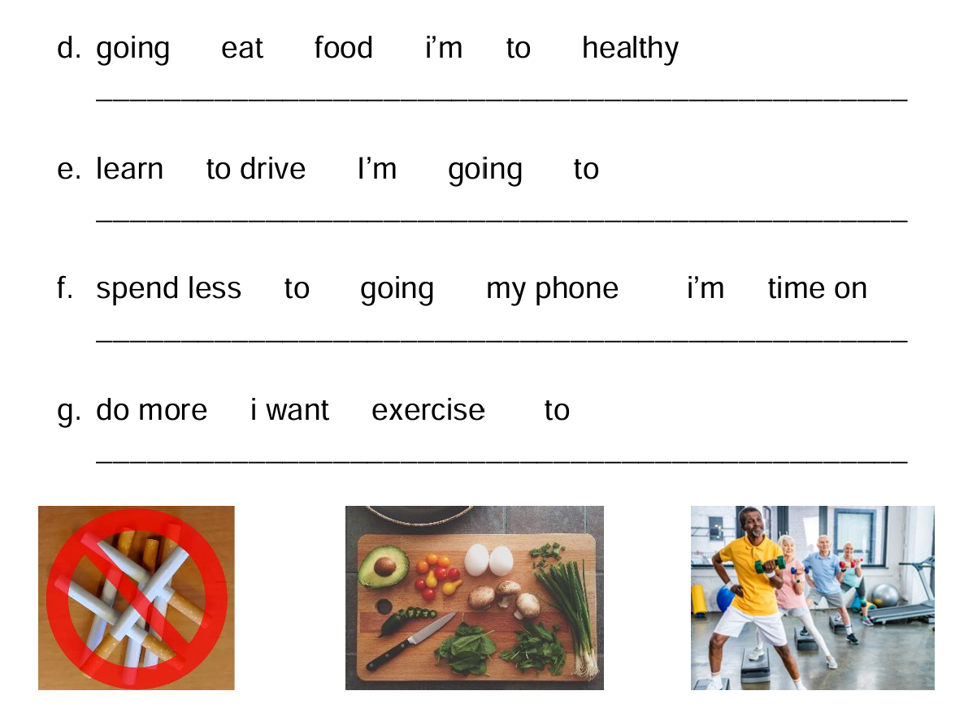

Slide 19
Your teacher’s New Year’s Resolutions
Look at your teacher’s goals for next year. Some are true but some are lies.
Which are true?
I’m going to learn to play the drums.
I’m going to learn Arabic.
I’m going to eat less sugar.
I’m going to learn to fly.

Slide 21
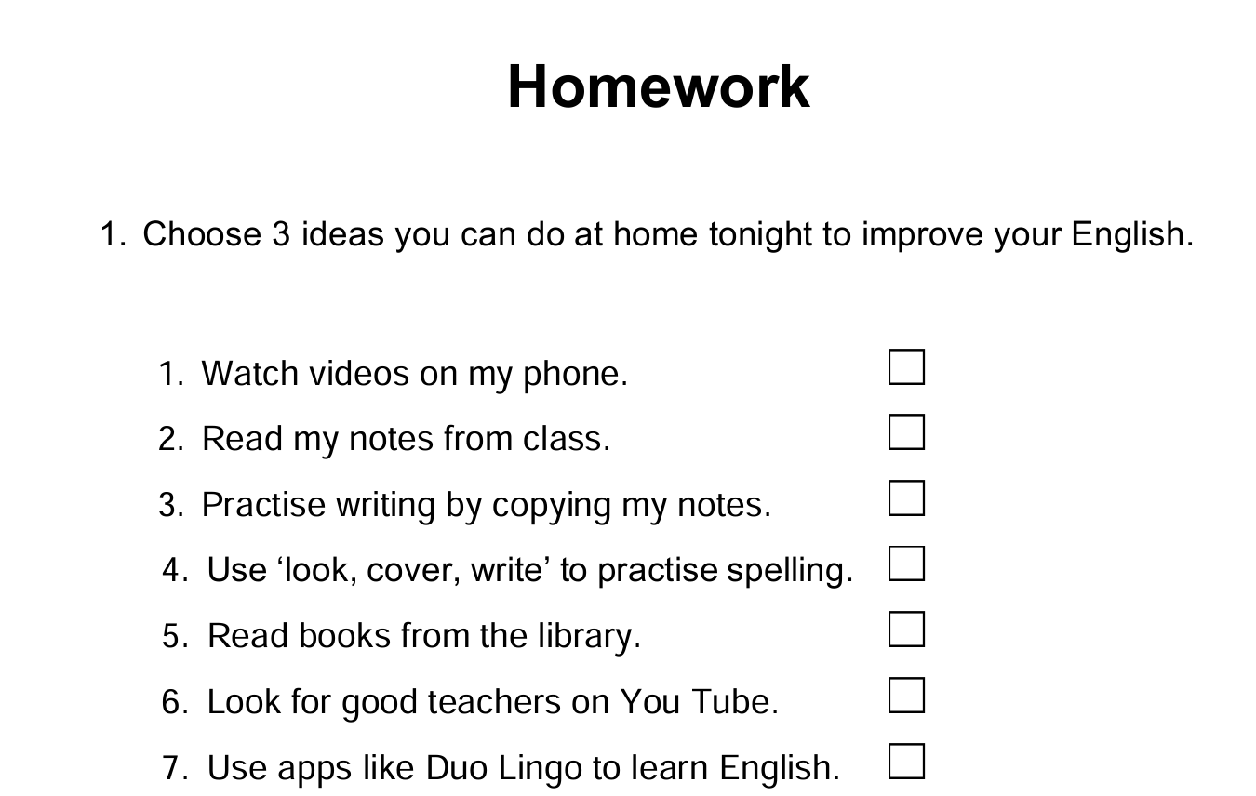

Slide 22
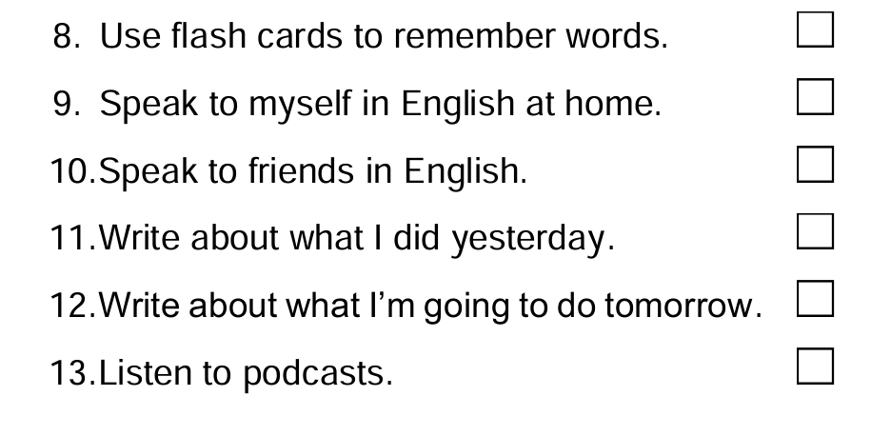

Slide 23
